Slide 1
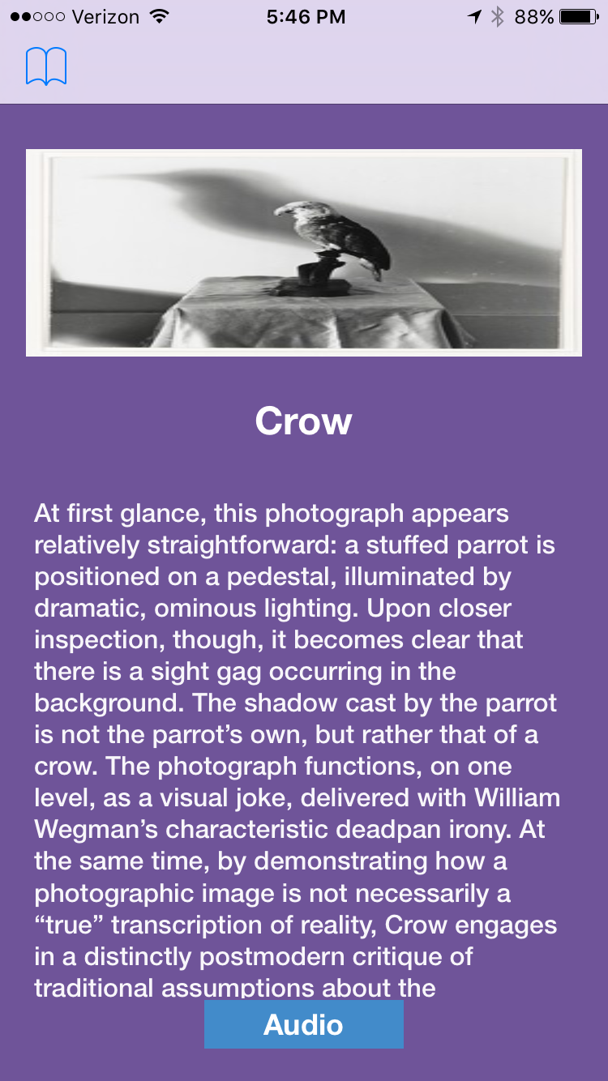
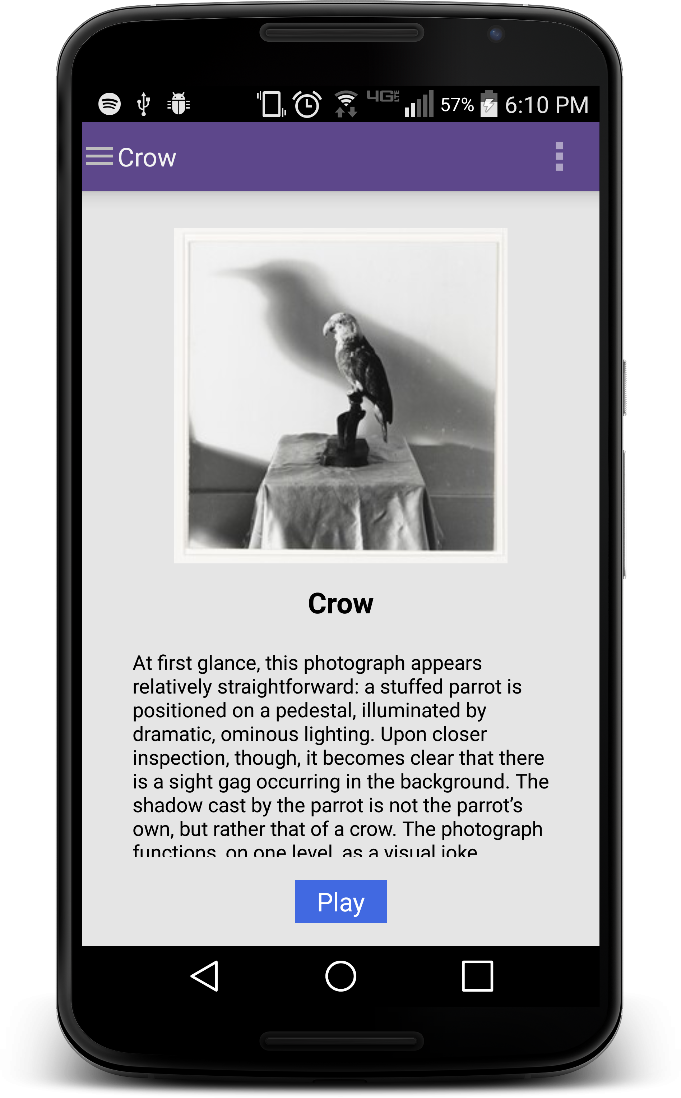
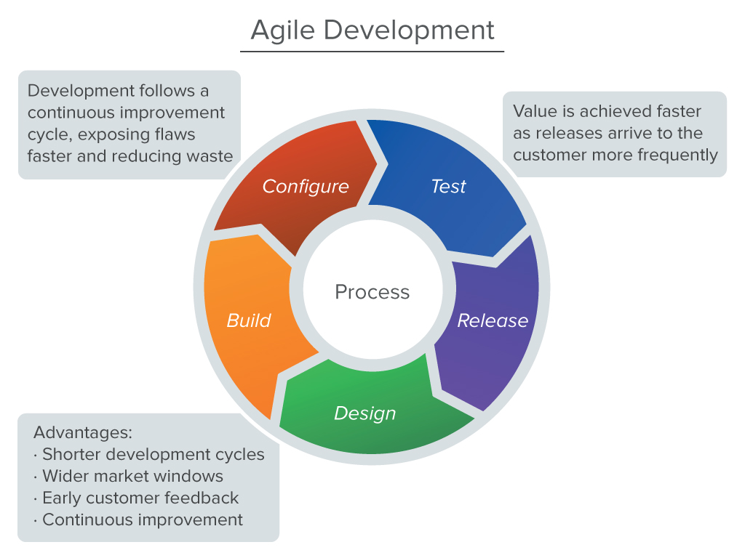
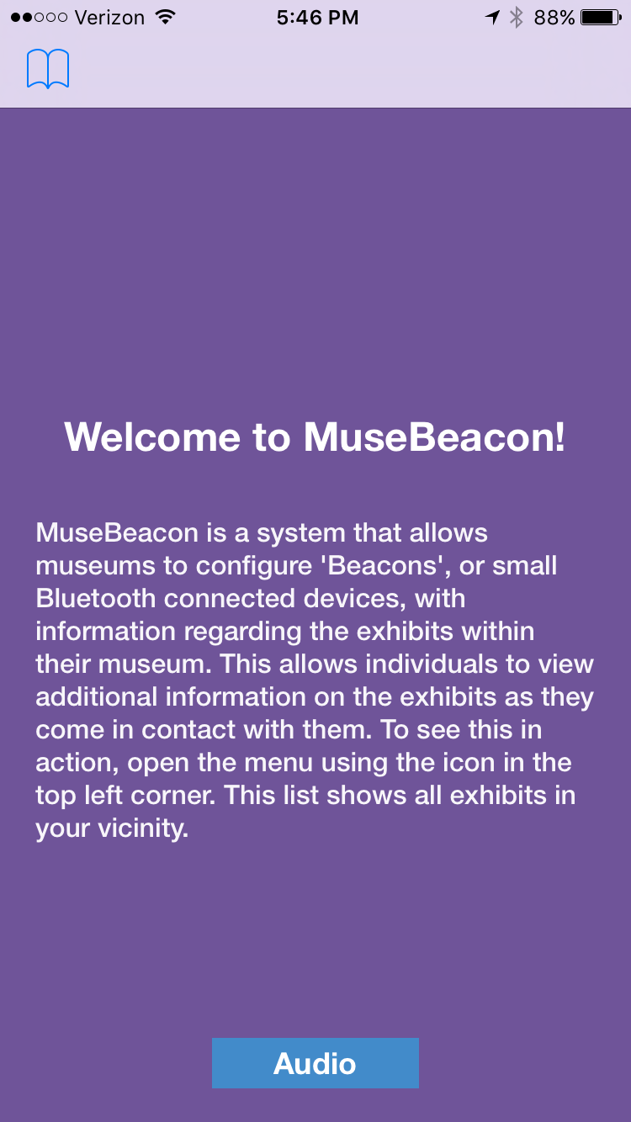
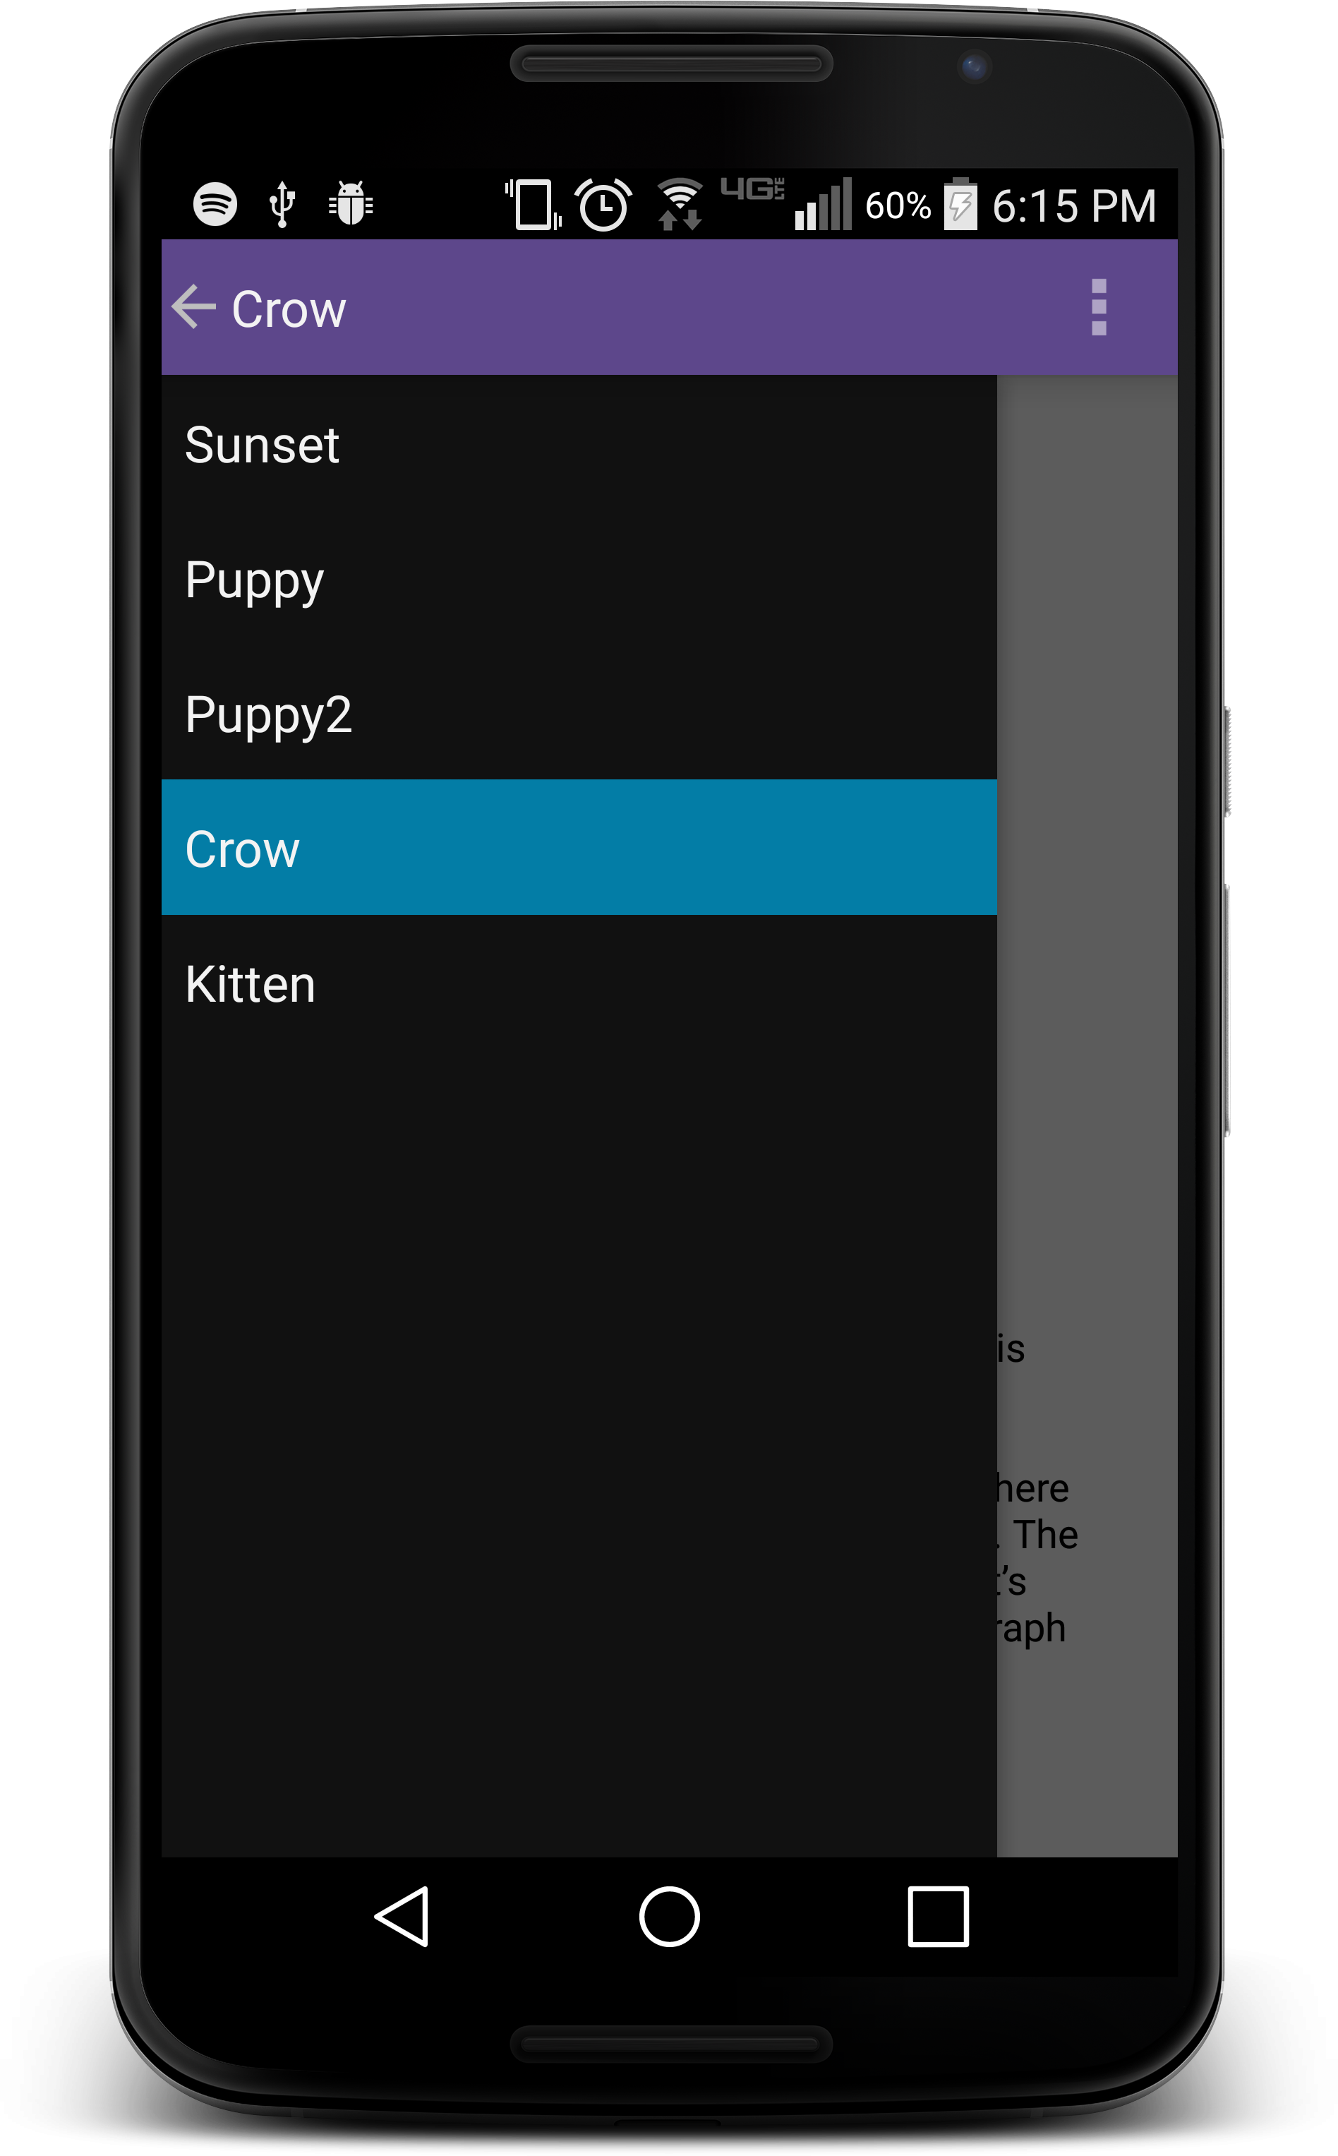



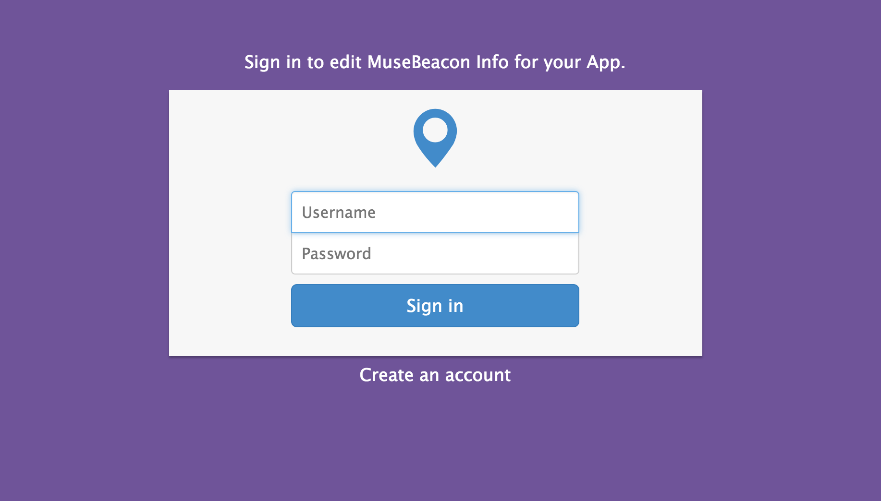


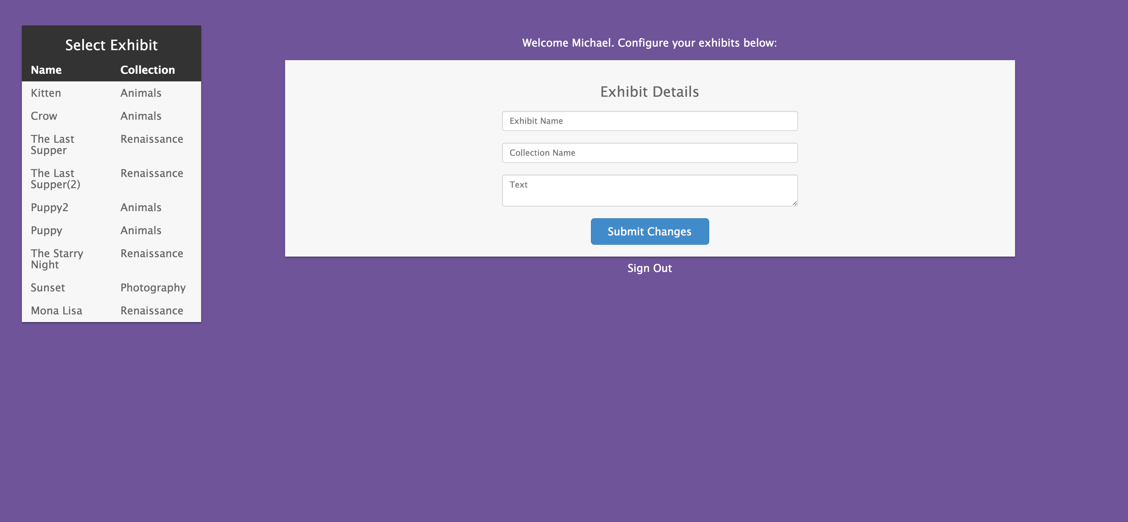
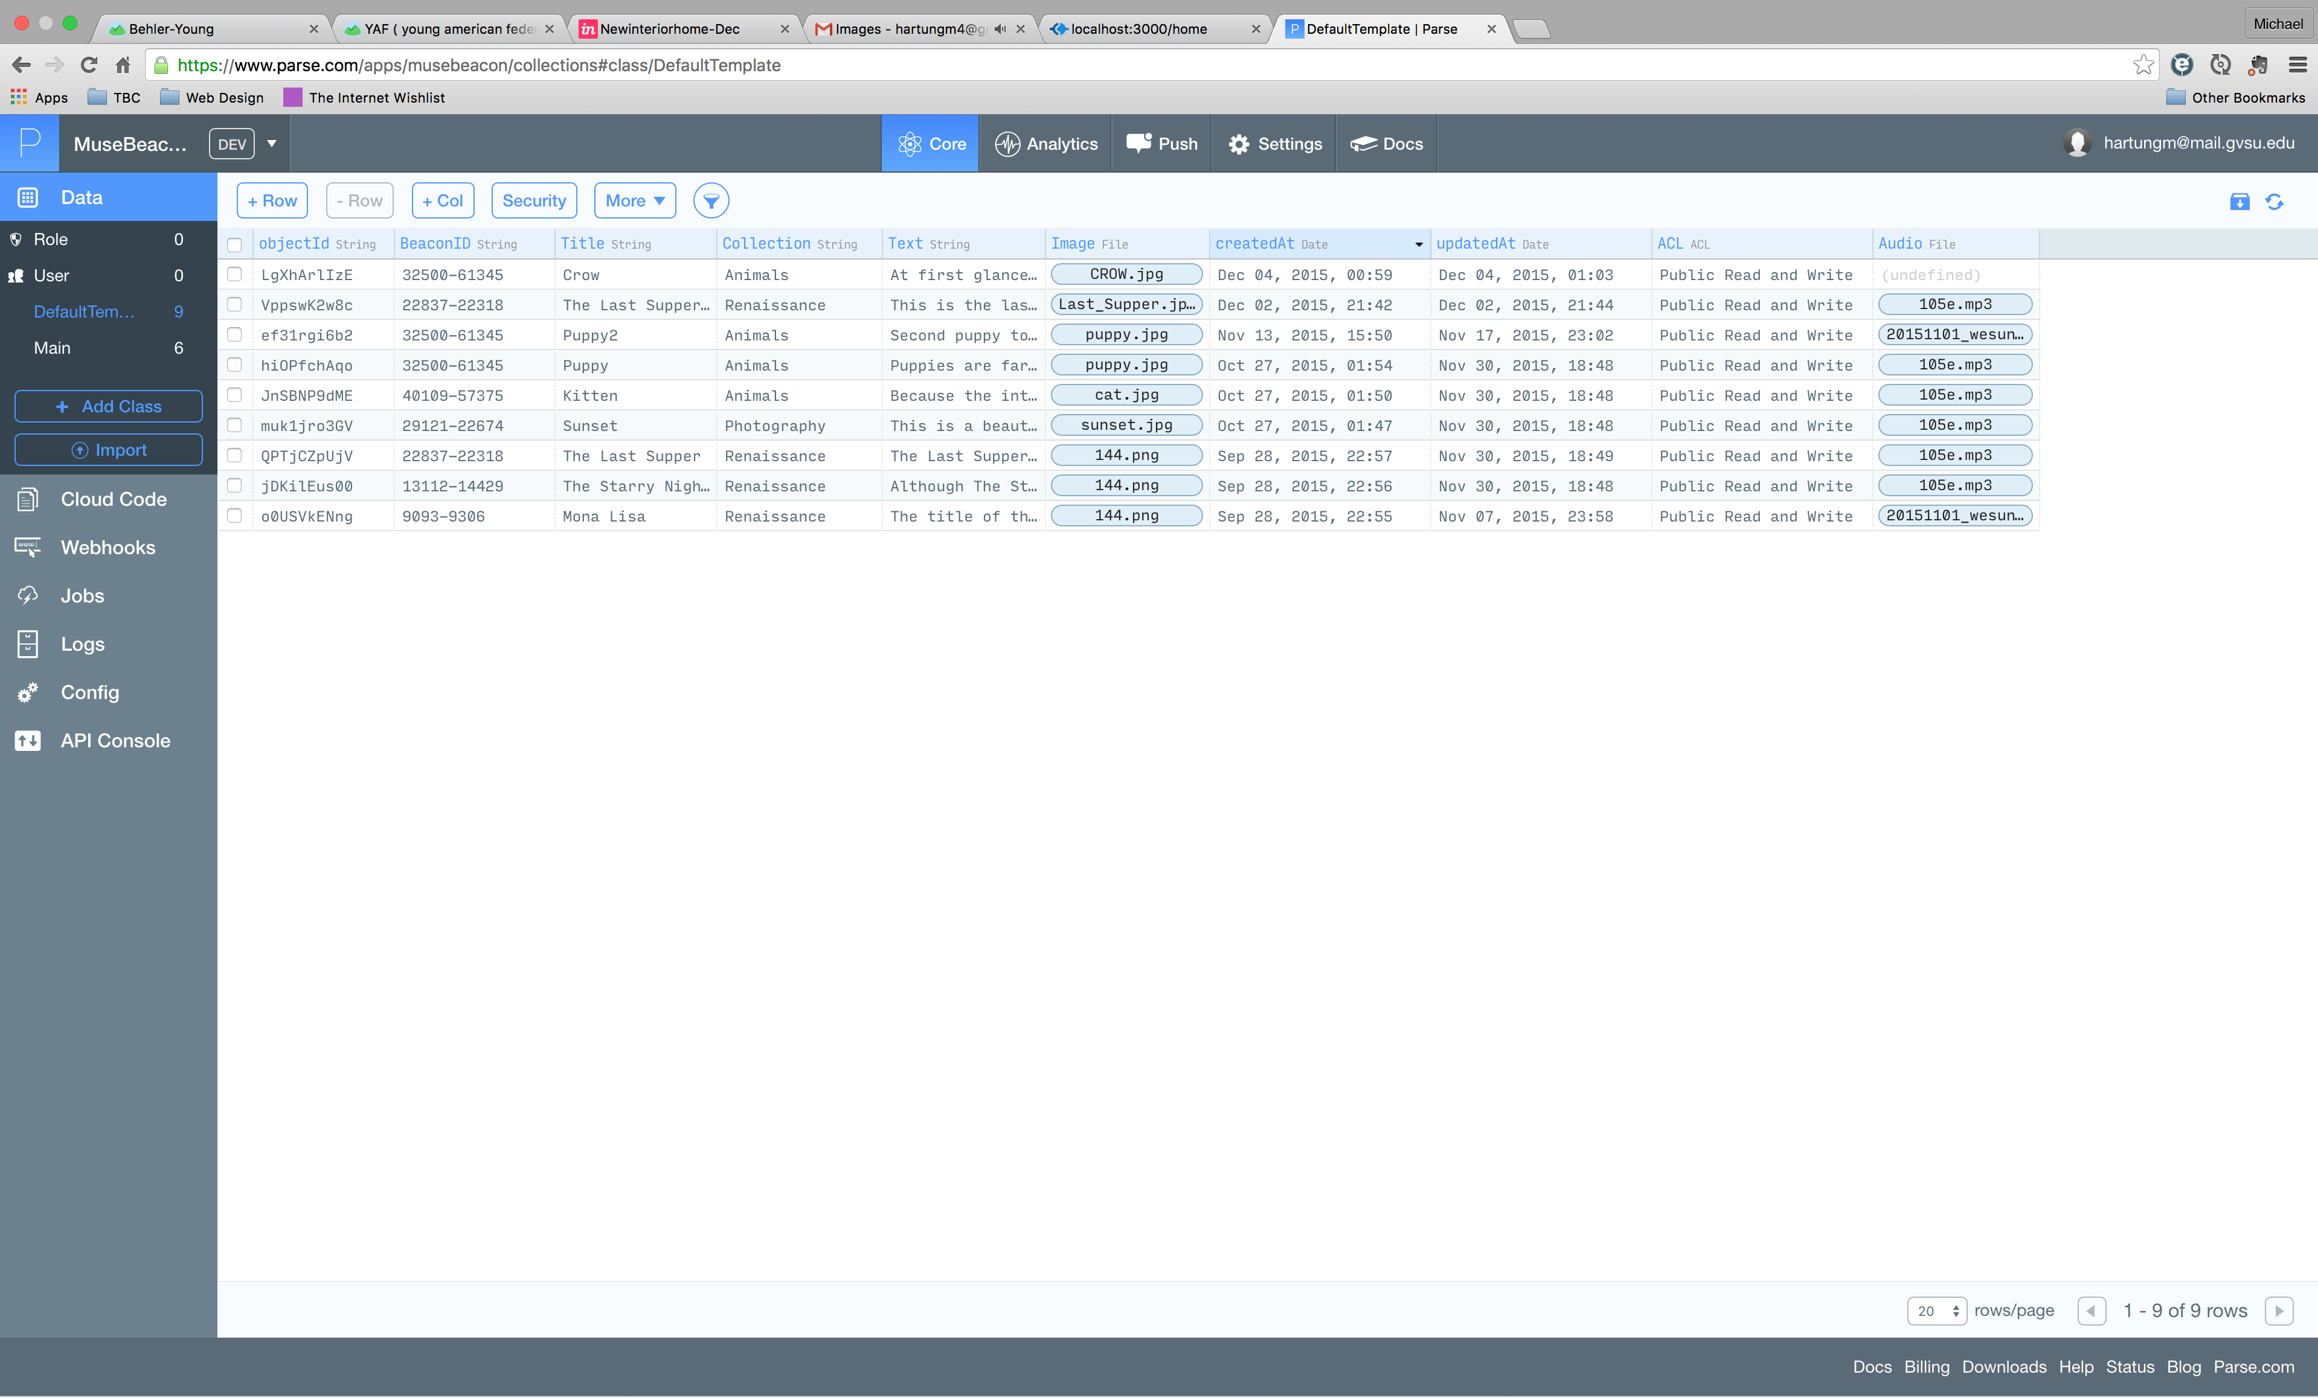
Museum Beacon System
Michael Hartung, Matthew Armand, Carlron Bennett, Gina Sietz, Dan Hoover
Introduction
Mobile
Process
We have developed a product which will allow museum professionals to configure “beacons” to work with exhibits in their museums. Our application can be used to display information about the exhibits. Our web application will allow the museum creative control over the information they would like to provide for each exhibit. This information may include additional descriptions, history, images, and audio to help their guests understand the pieces they are looking at.
For our project, we used the Agile methodology to plan what we would accomplish during each phase, or sprint. Essential to this planning process was the project management tool JIRA, which allowed us to assign tasks, detail levels of involvement for each task, and chart our progress. We started our project planning by making a list of features we would like our project to include. From this list, we developed a priority level for each task and estimated the time for completion. This document was helpful in deciding what features we would add for the next sprint. After assigning these tasks, we worked both independently and with other group members for the next two weeks on our individual project components. During the sprint, we pushed our code to our Github repository. After the sprint was complete, we met to show our progress, review our code, and plan the next sprint.
The iOS application uses Bluetooth Low Energy technology to detect beacons near it. This is accomplished using the CoreLocation iOS Framework which allows beacons to be detected. These beacons can then be used to display information about exhibits in a museum or art gallery.
The Android application uses Bluetooth Low Energy technology to detect beacons near it. The app will call out to a Parse database to retrieve the data associated with the beacons that it sees. The user can select which exhibit they would like to view from a drawer that pulls out from the left side of the screen.
What is a Beacon?
“Estimote Beacons are small wireless sensors that you can attach to any location or object. They broadcast tiny radio signals which your smartphone can receive and interpret, unlocking micro-location and contextual awareness.” – estimote.com
Android/iOS Mobile App
App pulls data from Parse
Parse Database
Museum updates exhibit data
Tools & Frameworks
Node.js Web App
Project Management
JIRA
Github
Toggl
Whiteboards
Communication
Google Hangouts
Android
Android Studio
Estimote SDK
Parse SDK
iOS
Xcode
Core Location Framework
Parse SDK
SWRevealViewController (Slider)
Web
Node.js
Express.js
Passport.js
MongoDB
Bootstrap
jQuery
Parse SDK
Jade Templating Framework
Go (Dropped)
Google App Engine (Dropped)
Image Courtesy of http://www.drew-fuller.com/agile-development-methodology-diagram.html
Web
Our web application implements a secure login with users stored in a Mongo database. Once the user logs in they can view and edit their beacon entries in a Parse database without directly using Parse.com. We chose this implementation so that multiple museums could use this system and view and edit only their beacon entries.
Future Implementations
Config App
Hotspot Tracking
Rating/Voting
Social Sharing
Appearance Improvements
More Template Options

